Slide 1
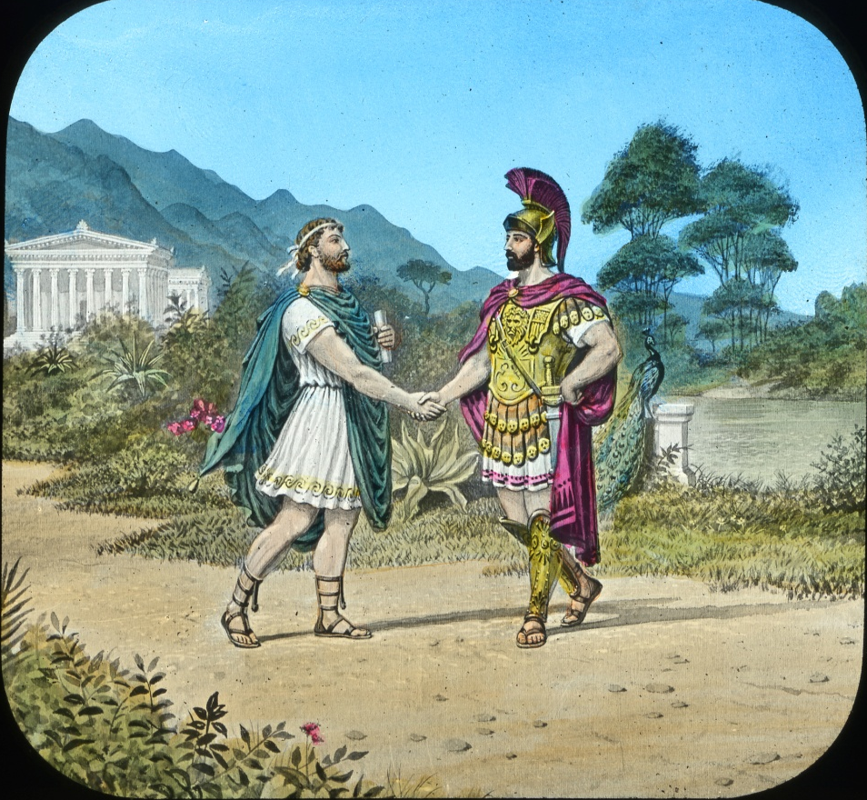
The Story of Damon and Pythias

Slide 2
The friendship of Damon and Pythias shines through the mists of centuries, a glowing tribute to the humanity of the past. It was made the sweet song of ancient Greece, and is immortalized in the permanence of our order.

Slide 3
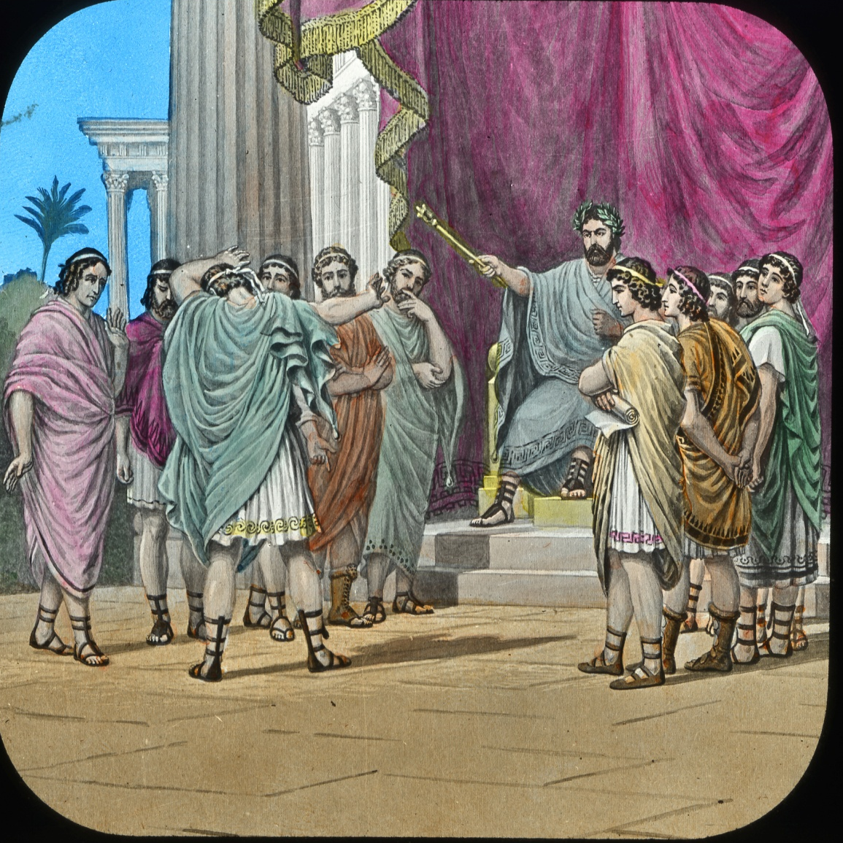
Damon a Senator of Syracuse, had incurred the displeasure of Dionysius, and was under sentence of death. Many delight\ted to honor him when he wore the robes of office; now he has but one friend in all Syracuse – the companion of his brighter better days.

Slide 4
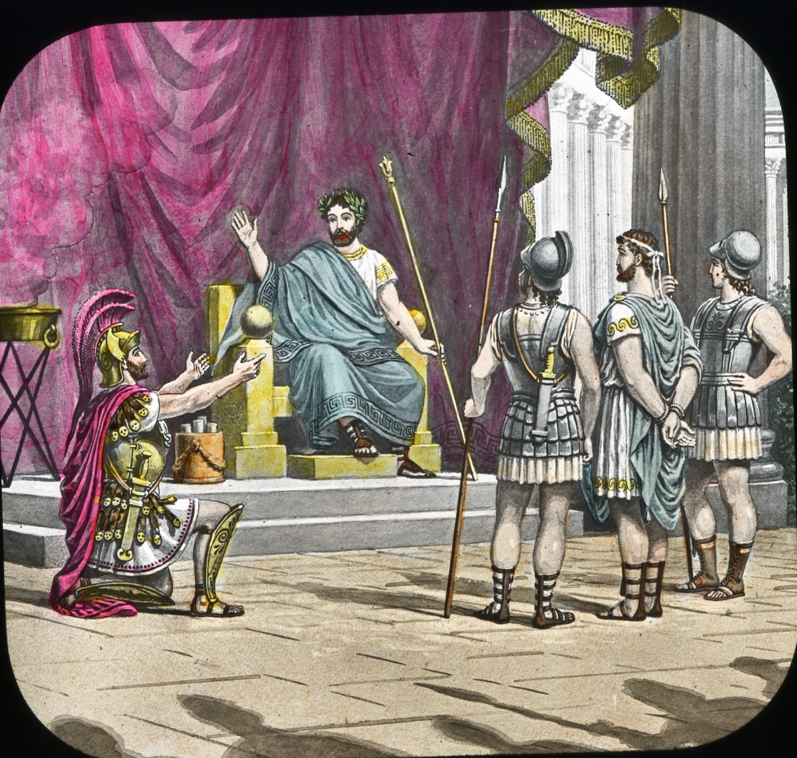
Pythias was true; knowing Damon’s love of home he begged the tyrant to grant his friend a respite, that he might see his wife and child before he died. A hero of many battles, a stranger to the art of speech, his love for Damon inspired a most eloquent appeal.

Slide 5
As thou art a husband and a father, here me!
Let Damon go and see his wife and child
Before he dies, For four hours respite him;
Put me in chains; plunge me into his dungeon,
As pledge for his return. Do this – but this-
And may the gods themselves build up thy greatness
As high as their own heaven
The fervor of this strange request touched the heart of Dionysius. It was to him a mystery. He lived for self alone; he had sacrificed his friends, his honor, his home, upon the alter of a boundless ambition, for place and for power. To him friendship was ambitions ladder.

Slide 6
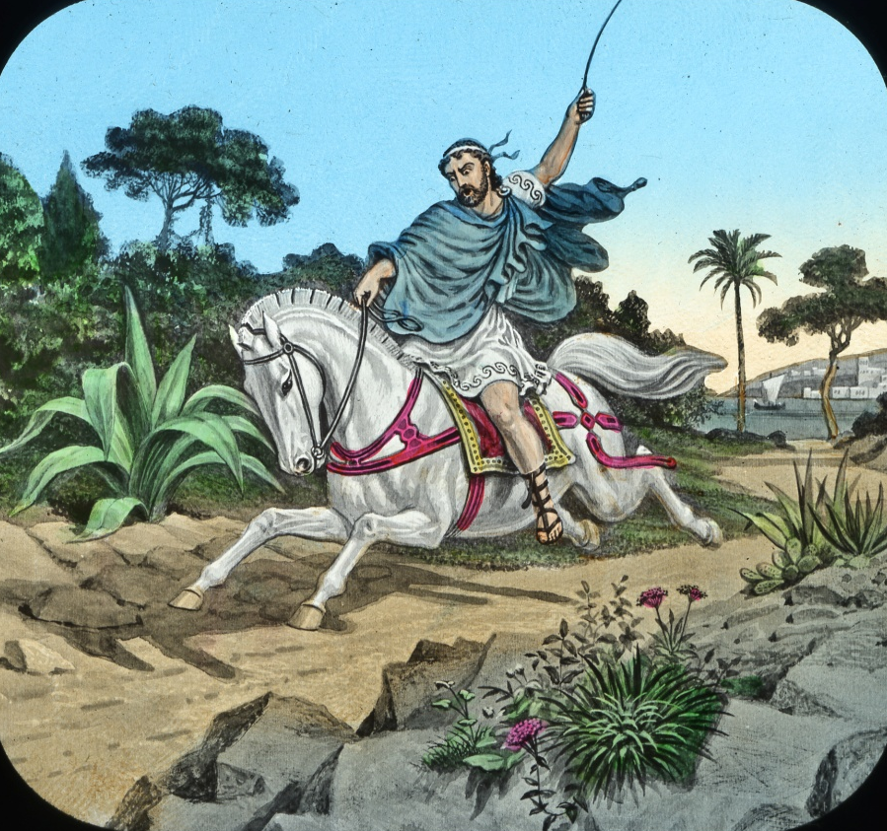
The request was granted, and Pythias became a hostage for Damon, who hastened toward his home by the distant sea.

Slide 7
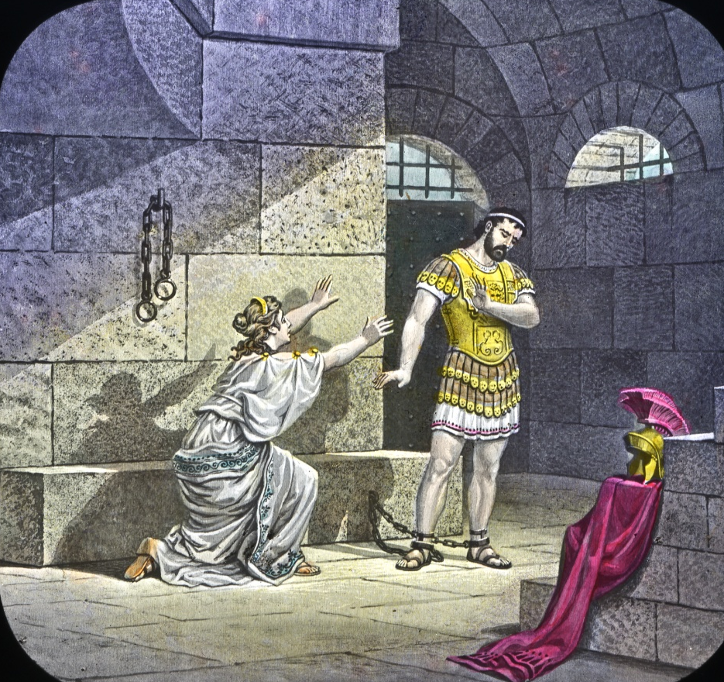
The mystery deepens – the tyrant cannot solve it.
By his decree, in the lone dungeon where Pythias wears his chains, the fair Calanthe urges her lover to break his bond and fly with her where dangers cannot come.
He will not go; he has pledged his word; honor is more to him than life – and in his refusal the tyrant marvels still the more.

Slide 8
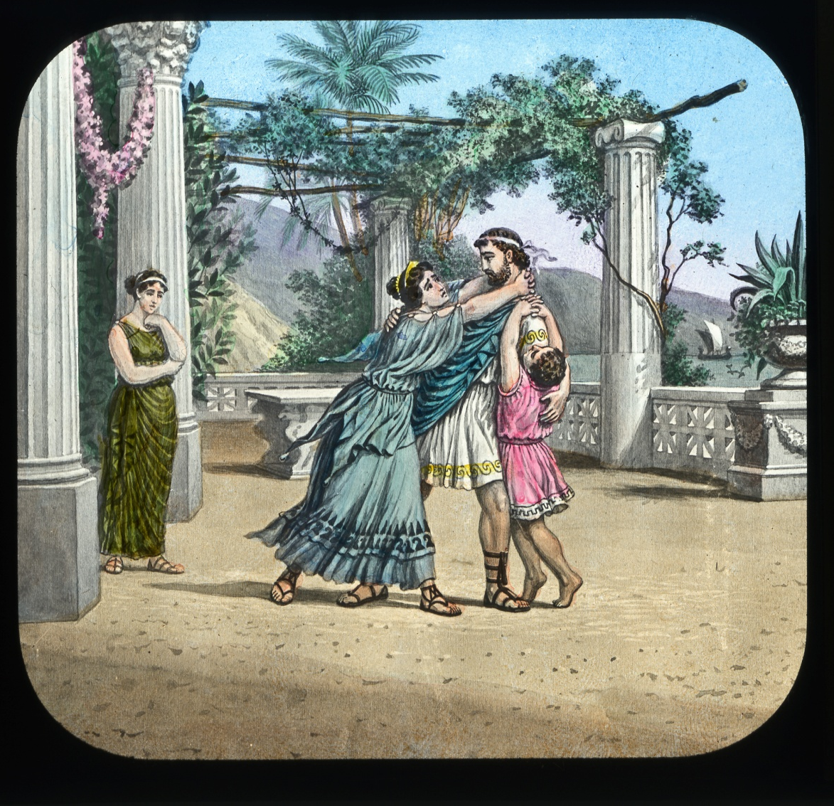

Slide 9
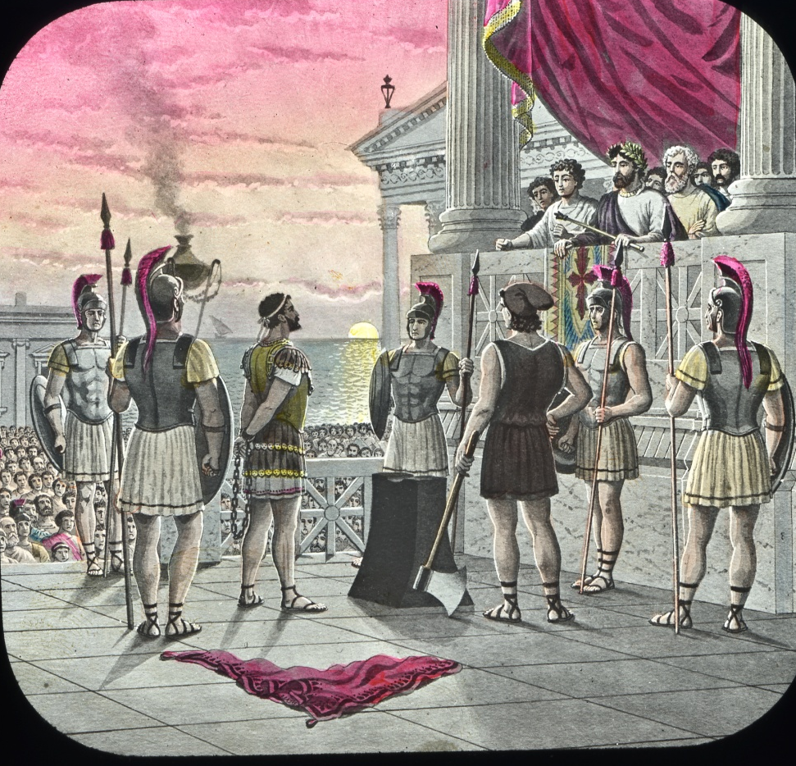
The hour of execution is at hand; Damon has not returned; and his hostage is brought to the block to suffer in his stead. The evening sun shines golden on the towers and temples of ancient Syracuse, as Pythias looks out upon the vast throng, who taunt him with the seeming falseness of his friend. Relying upon the honor of Damon, trusting his word, proud of his friendship, he calls upon the gods to prevent his return; and, in response to the cruel jeers of the mob, proclaims the fidelity of Damon, and turns to meet his fate.

Slide 10
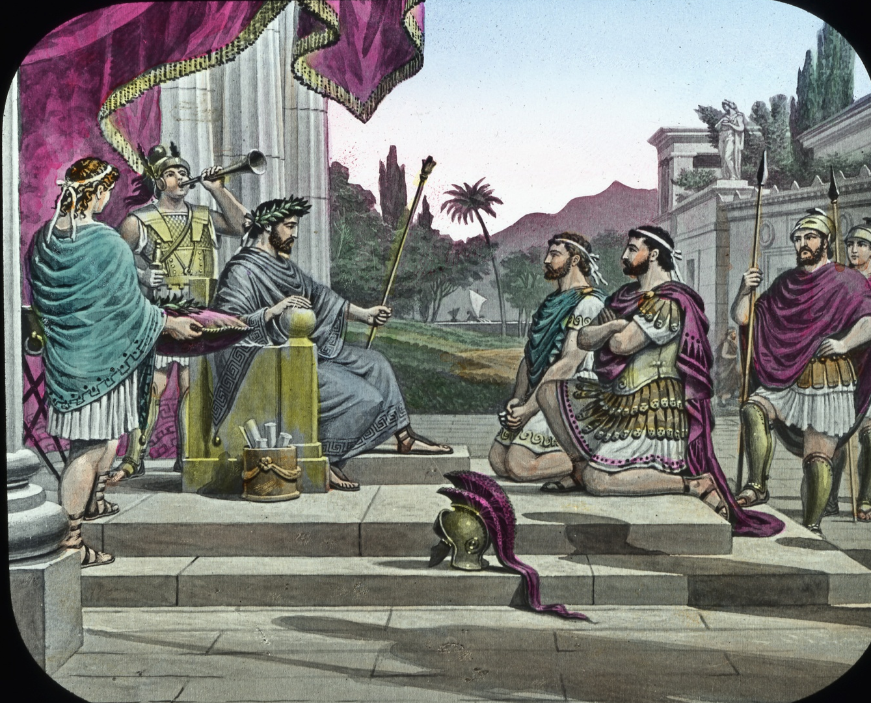
At the strange scene the tyrant looks in wonderment; and, as he looks, the cruel purpose of the hour passes away, and friendship sits upon the throne, wearing a crown “that ne’re encumbers nor can be transferred”.

Slide 11
These heroes still live, and will live while friendship warms the heart of man. This virtue is the cornerstone of the Order Knights of Pythias, and our members are sworn to exercise it toward each other.

