Slide 1
RANK OF KNIGHT SHORT FORM

Slide 2
Master at Arms
Esquire, ere you leave this room in quest of further knowledge of our mysteries, I ask of you a pledge that you will not improperly reveal anything that you may see or hear to-night. Do you make this pledge?

Slide 3
Esquire, you will be seated here, where you will remain alone. When. you shall hear three strokes upon the bell.
You will wait in silence.

Slide 4
MONITOR
He that hath light within his own clear breast may sit in the center of the night and enjoy bright day;
But he that hides a dark soul and foul thoughts, benighted walks beneath the midday sun

Slide 5
The darkness which surrounds you is symbolic of life. You sit in solemn meditation and the purpose of your existence is to render service to your God and to your fellow man.

Slide 6
Thus shut out from the light of day—”the world forgetting, by the world forgot”—learn now from me the highest purposes of our order.

Slide 8
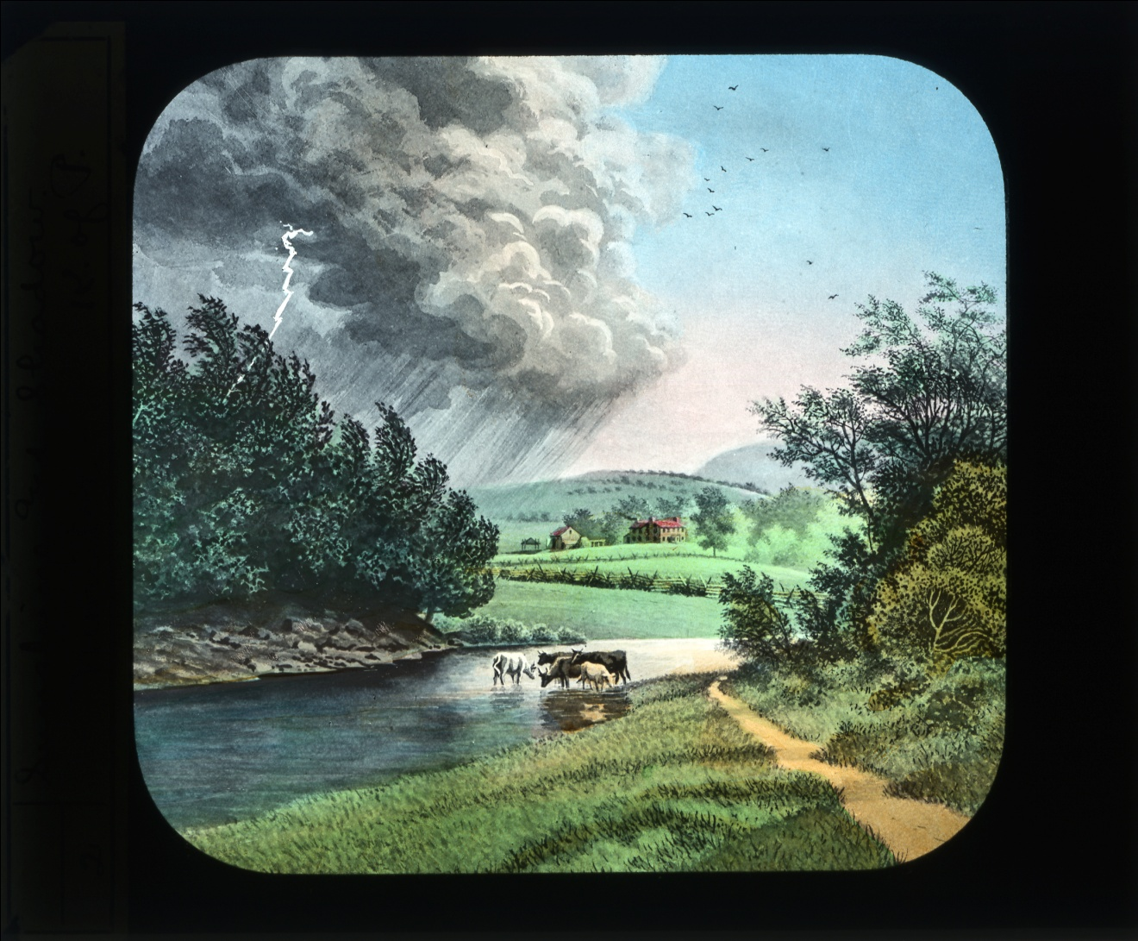
Life has its sunshine and its shadow; its days and its nights; its seasons of joy and its hours of sorrow. In this great drama every Pythian has a part-a duty to himself, a duty to his family, a duty to his fellowman. Out of the silence of the darkness which entombs you, I would have you learn the duty of a Pythian Knight.

Slide 9
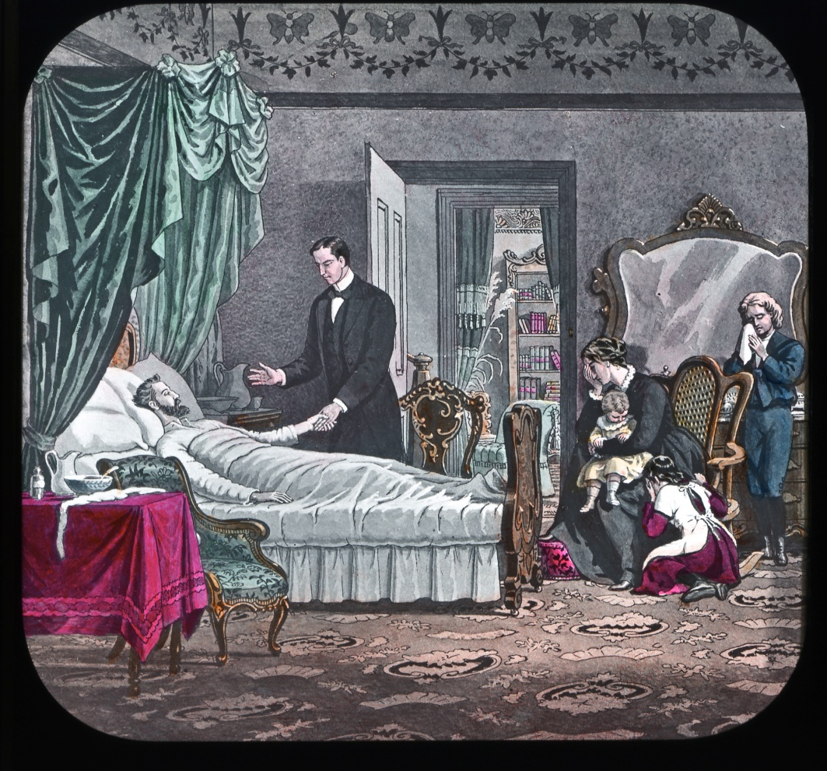
When the darkness of death comes to the home of a friend, your duty is there, to comfort, to console, and if possible to point out, through the gloom of sorrow’s night, the stars that shine beyond.

Slide 10
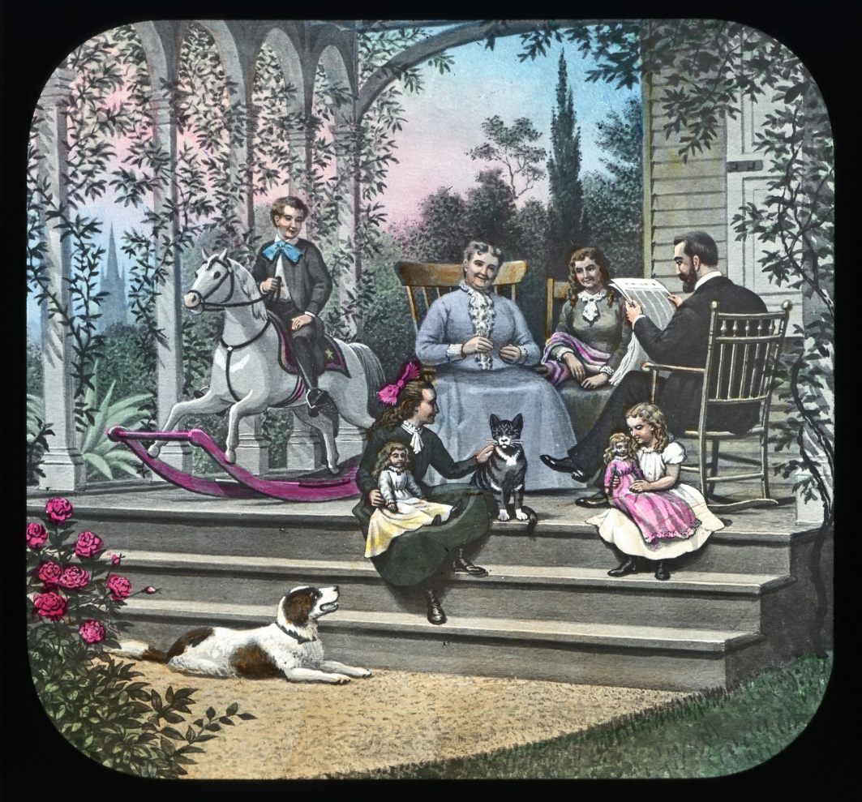
To share and have part in the sorrows of our friends broadens the vision, tempers the heart, and makes golden the light that falls upon the hearthstone where we with loved ones dwell.

Slide 11

Night has glories that the day can never reveal. The day tells of the budding flowers, the sparkling stream, the lights and shadows of the grand old wood.

Slide 12
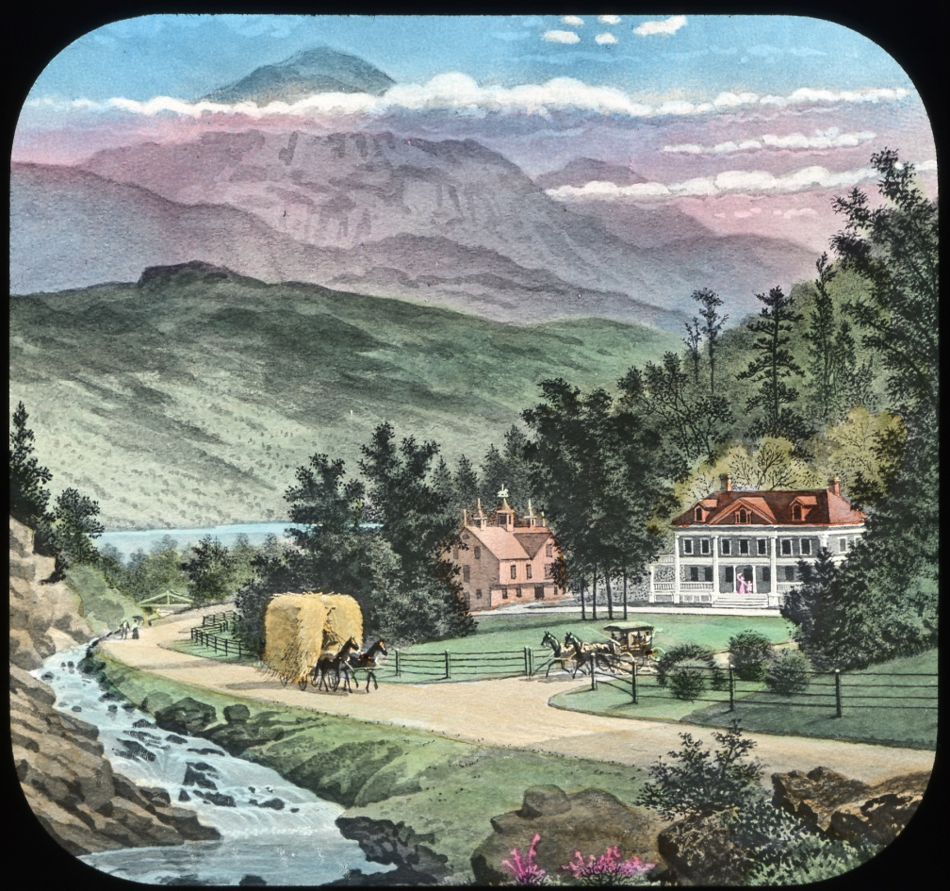
We see the majestic mountain, and the peaceful homes brightening the valleys rich in bounteous nature’s golden harvest.

Slide 13

We arise in the morning, when dewdrops sparkle like diamonds upon the opening flower; we go forth at eventide, when the sunset glows with rubies – but, look where we may, the vision of the day is prescribed. When tired day has sunk into the arms of restful night.

Slide 14
“HEAVENS EBON VAULT
STUDDED WITH STARS UNUTTERABLY
BRIGHT
SEEMS LIKE A CANOPY WHICH
LOVE HAS SPREAD
TO CURTAIN HER SLEEPING WORLD

Slide 15

Gaze on the silent, shining spheres, as in eternal, unerring cycles they move like silver barques upon the azure sea of heaven, and, as from each of them there radiates some light to brighten and to bless, so, when the night of sorrow darkens the home of a friend, be thou a star of sympathy and love,

Slide 16
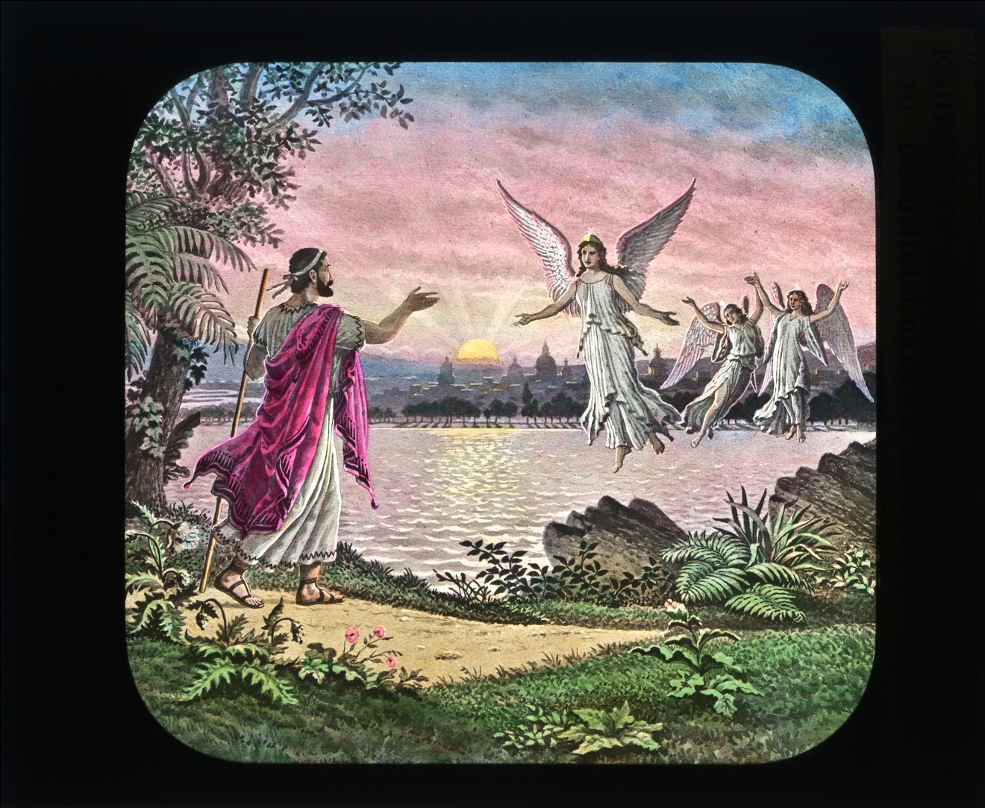
From which, across the path of those to whom life seems a never ending night, shall come bright beams of hope. Let words of council and cheer, set to the music of fraternal love, fall from your lips, giving a glow to the cheek, a sparkle to the eye, and hope to the heart, of him who hears.

Slide 17
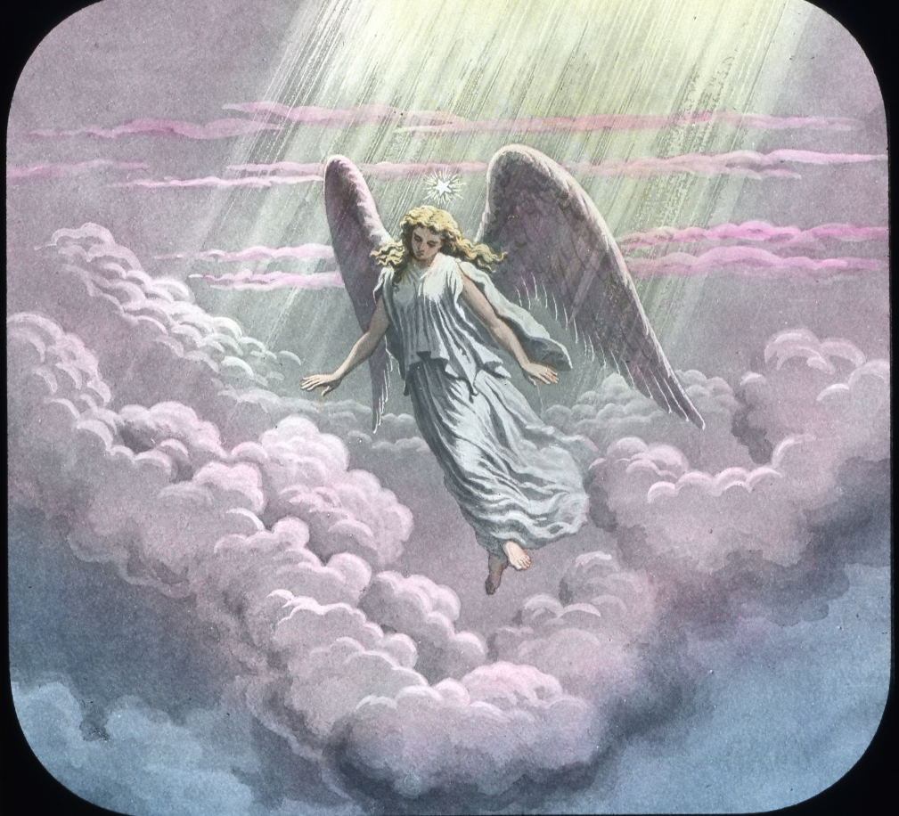
May they fall like rays of light from a heaven of peace!

Slide 18
Master at arms
Chancellor Commander, I present Esquires, that he may meet the test of steel
Chancellor Commander
All who have attained the rank of Knight have been required to undergo this test, that the measure of their courage and confidence might be known.
Is it your desire that we proceed?

Slide 19
Esquire, you will carefully examine this instrument, and fully satisfy yourself as to its composition.
Master of Arms, place the test!
You see that it is a solid slab of oak, in which are firmly set sharp spikes of steel

Slide 20
Esquire, this test may seem to you cruel and uncalled for; and, while there is much I dare not reveal, I wish to say: a moral coward is often tempted to deeds of reckless daring, rather than face the jeers of those about him. A man of courage and noble purpose will by no act of his do violence to his manhood. With confidence in himself and in his friends, prudence marks his conduct and success crowns his life.

Slide 21
With this admonition, and the assurance that you are to be the judge of what is prudent, I bid you meet the test.
Master at Arms, conduct the Esquire to a seat, prepare him properly, and present him before the test.

Slide 22
Esquire, you see before you three steps, representing the three ranks of this order.
Advance upon the first step.
This step is emblematic of the rank of Page. What is the motto of that rank?
Advance upon the second step.
This step is emblematic of the rank of Esquire. What Is the motto of that rank?
Advance upon the third step.
This step is emblematic of the rank of Knight.

Slide 23
King
Esquire, you have presented yourself as an aspirant for the honors of knighthood, avowing your readiness to undergo any test that might be imposed upon you. Therefore, I bid you instantly to , Jump

Slide 24
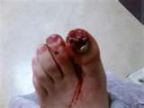
Last Jumper

Slide 25
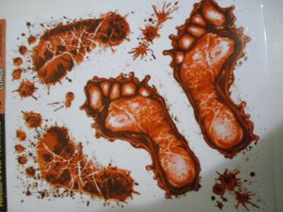

Slide 26
In the ceremonies just ended, there are lessons which you may apply with profit to the affairs of life.

Slide 27
In the test you were called upon to meet, we sought to impress you that a Knight of Pythias should be obedient to every official command, and that, with confidence in his brethern, he should fearlessly do his duty.

Slide 28
With this explanation, I ask you: Will you endeavor to aid in disseminating the principles of our order?
Master at Arms, The Esquire having expressed His willingness to aid in disseminating the principals of our order, you will present him to the Prelate, who will administer to him the obligation of The rank of Knight

Slide 29
Prelate, by order of the Chancellor Commander, I present an Esquire, that he may assume the obligation of the rank of Knight.

Slide 30
Prelate
Advance your right foot, place your left hand on your left breast, bring your right hand in front of your body, grasping the hilt of the sword, as it rests on the book of law, and repeat after me.

Slide 31
I solemnly promise that I will always, to the extent of my ability, relieve a worthy knight in distress, endeavor to warn him of any danger which I may know to threaten him or his family, and to aid him whenever and wherever I may be convinced that he is in need.

Slide 32
I further promise that I will obey the orders of this
lodge, the Grand Lodge having jurisdiction over it,
and of the Supreme Lodge Knights of Pythias, and
the official mandates of the executive officers thereof.
To the faithful observance of this obligation I pledge my sacred word of honor. So help me God-and may he keep me steadfast.

Slide 33
Master at Arms, conduct the Esquire to the Vice
Chancellor for instruction.
Vice Chancellor, by direction of the Prelate, I pre-
sent to you an Esquire for instruction.

Slide 34
I will now instruct you in the secret work of this
rank.
When the lodge is open in the rank of Knight, and you desire admittance to the ante-room, you will make your presence known at the outer guard.

Slide 35
You will give him the semi-annual password. He will then admit you to the ante-room. You will approach the inner door, and give thereon ___________, which will be answered from within by _____________ .

Slide 36
The door will then be opened, and through it you will give your name and rank These will be reported to the Vice Chancellor, who will order you admitted if correct.
The door will again be opened, and through
it you will give in a whisper the password of this rank, which is____________

Slide 37
You will then be admitted to the lodge-room, and will advance to the altar, on which will rest the open book of law, with one sword lying
diagonally across the book, the hilt toward your right hand. There you will salute the flag of our country, as in the preceding ranks.

Slide 38
You will then give to the Chancellor Commander the sign of courtesy, thus: ~ .
This sign must be given by all who enter the lodge while open in this rank, except by those who are returning after having executed an order of the Chancellor Commander.
The Chancellor Commander will answer it
by _______ , which indicates permission to be seated.

Slide 39
Should you desire to retire before the lodge has been closed, unless leaving the lodge-room to execute an order of the Chancellor Commander, you will advance to the altar and salute the flag of our country. You will then make this sign: ________ ~ . Should the Chancellor Commander answer it by _______ , you may retire-otherwise, you will return to your seat. In both these signs, your fingers represent the bars of an open- barred visor, such as knights formerly wore on their helmets.

Slide 40
As, in ancient times, a knight, entering a
castle or camp of his friends, raised his visor to disclose his identity, so you, entering a Pythian castle hall, make this sign: . When going outside, where he would surely meet strangers and possibly enemies, he lowered his visor, to protect his face and conceal his identity; so you, when leaving a castle hall, make this sign: _____________ .

Slide 41
The gavel is the emblem
Of the authority of the Chancellor
Commander , and is used to preserve
Order, call the members of the lodge
To their feet and seat them—one rap
Calling the lodge to order, two raps
All themembers to their feet and
Three raps seating them

Slide 42
In the examination of those present prior to the opening of the lodge, you will give to the Master at Arms the semi-annual password and the password of the rank of Knight.

Slide 43
At the opening of the lodge, when the question is
asked, "What is the duty of every member of this
order?" you will assume the position taken when the obligation of the rank of Knight was administered, and respond, "To avoid anger and dissension, to work together in the spirit of fraternity, to exemplify the friendship of Damon and Pythias."

Slide 44
The motto of this rank is ____________

Slide 45
The arrangement of the book of law and
The swords of defense on the altar, which as you
Have seen differs in each rank, is to indicate
to the members of the rank in which the
Lodge is open.

Slide 46
In the rank of Page it is two swords Crossed beneath the open book of law with the Points toward you, in the rank of Esquire the swords
Rest crossed upon the book of law and points Toward you.

Slide 47
Master at Arms, conduct the Esquire to the Chancellor Commander.
Chancellor Commander, by direction of the Vice Chancellor, I present these Esquires to you.

Slide 48
Esquire, you have been informed by the Vice Chancellor that, in order to gain admittance to the ante-room, when the lodge is open in the rank of Knight, you must give to the
Outer Guard the semi-annual password.

Slide 49
The semi-annual password, as its name indicates, is a word which is changed twice in each calendar year. Every subordinate lodge of Knights of Pythias uses the same semi-annual password during the current semi-annual term.

Slide 50
This word must be given at the outer door, in every rank, by all who have attained the rank of Knight. The semi-annual password for the present term is_______

Slide 51
If you are not entitled under the law to the semi-annual password, you will be so informed, and you can not be admitted until you take the steps necessary to entitle you to it. No one, under any circumstances, except a candidate for the rank, under escort, can be permitted to enter or to remain in a lodge open in the rank of Knight

Slide 52
Unless, he is in possession of or entitled to the semi-annual password. If you are entitled to it, the Outer Guard will be ordered to admit you to the ante-room. Immediately on entering the lodge-room, you will proceed to the station of the Chancellor Commander and receive the word

Slide 53
You can receive it only from the Chancellor Commander of the lodge of which you are a member (who can communicate it to you in or out of the lodge-room), or from the Chancellor Commander of another lodge, to whom you present an official receipt for all indebtedness to you lodge to the end of the current semi-annual term

Slide 54
You will kneel on your right knee.
By virtue of the power vested in me as Chancellor Commander of this lodge, and in the name of the order universal, I create you a Pythian knight.
Be friendly [one blow], be cautious [one blow], be brave [one blow].
Who wins the spurs should wear them. Rise, Knight , and stand among your peers.

Slide 55
I now invest you with the insignia of Knighthood.
This jewel is an emblem of the highest rank this lodge can confer; that you will wear it worthily we earnestly believe.
As a Knights of Pythias, speak the truth; uphold
the right; protect the weak; relieve the distressed.
Remember always that, as you illustrate in your daily life the friendship, the charity, the benevolence, that we teach, you will bring honor to the order which now gives you welcome.

Slide 56
Master at Arms, face the Knight to the lodge.
Master at Arms:
Officers and members of STONEWALL-JASPER Lodge, No. 6 ,
I present to you Knights
The lodge will be at ease.

