Slide 1
RANK OF PAGE

Slide 2
Master at Arms: Gives the alarm of rank
Inner Guard: Who comes here?
Master of Arms: The Master at Arms of this lodge, with _______ strangers who desire to be initiated into the mysteries of the rank of Page, applies for admission!

Slide 3
Inner guard:
Chancellor Commander, the Master at Arms of this lodge, with strangers who desire to be initiated into the mysteries of the rank of Page, applies for admission
Chancellor Commander: Admit them

Slide 4
PYTHAGORAS!
PYTHAGORAS!
PYTHAGORAS AWAKE!
PYTHAGORAS AWAKE!

Slide 5
WHO DARES TO DISTURB THE
DELIBERATIONS OF PYTHAGORAS

Slide 6
MASTER OF ARMS
NEOPHYTES!! PYTHAGORAS!!
NEOPHYTES

Slide 7
PYTHAGORAS
NEOPHYTES?
NEOPHYTES?

Slide 8
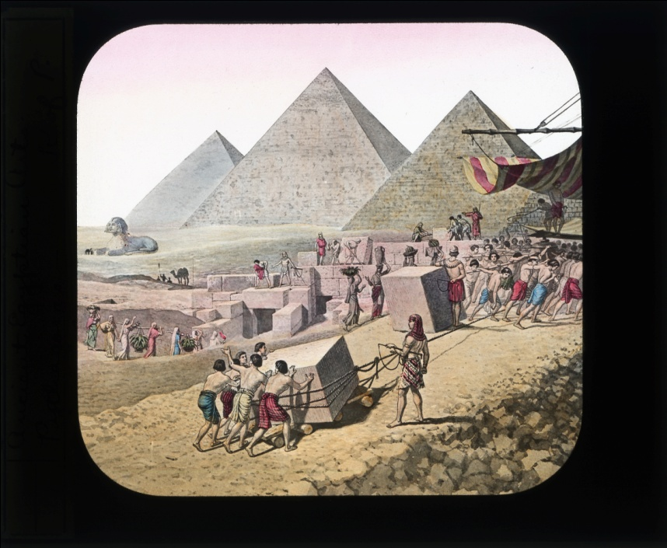
In me behold Pythagoris, Centuries before your eyes had opened on the light of day, I had attained the knowledge of all ages. The arts of ancient Egypt,

Slide 9
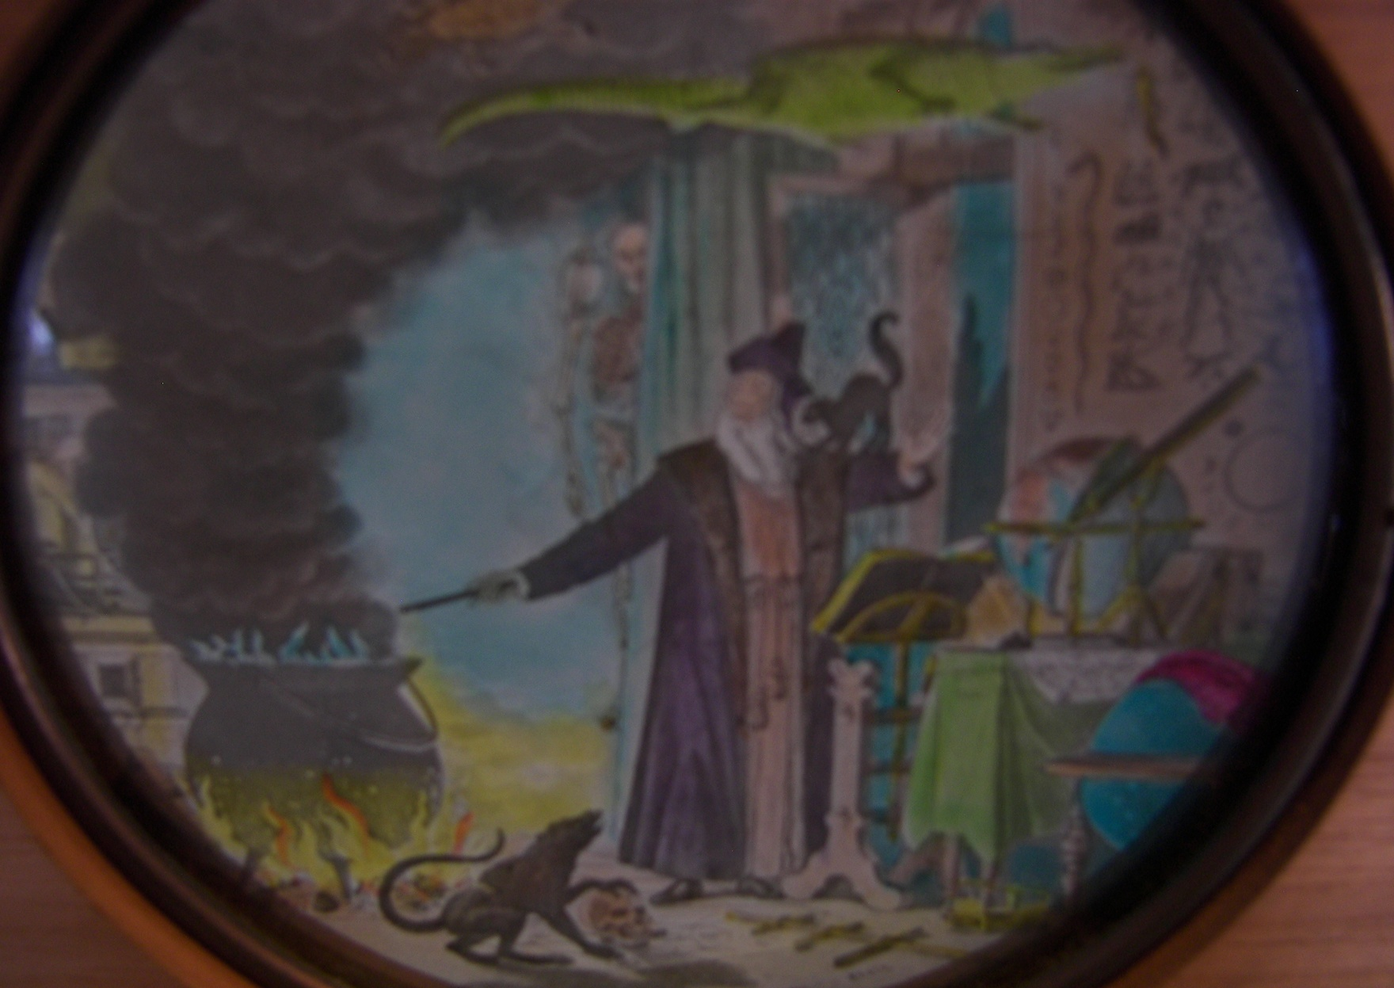
The science of Arabia,
And the philosophy of Phoenicia

Slide 10
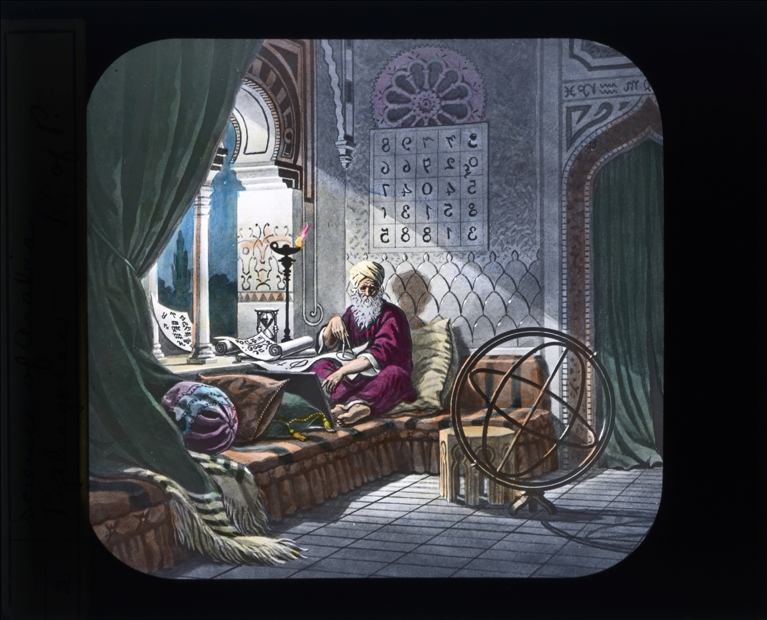
The lore of the Chaldeon sages and the occult mysteries of the Persian magi,

Slide 11
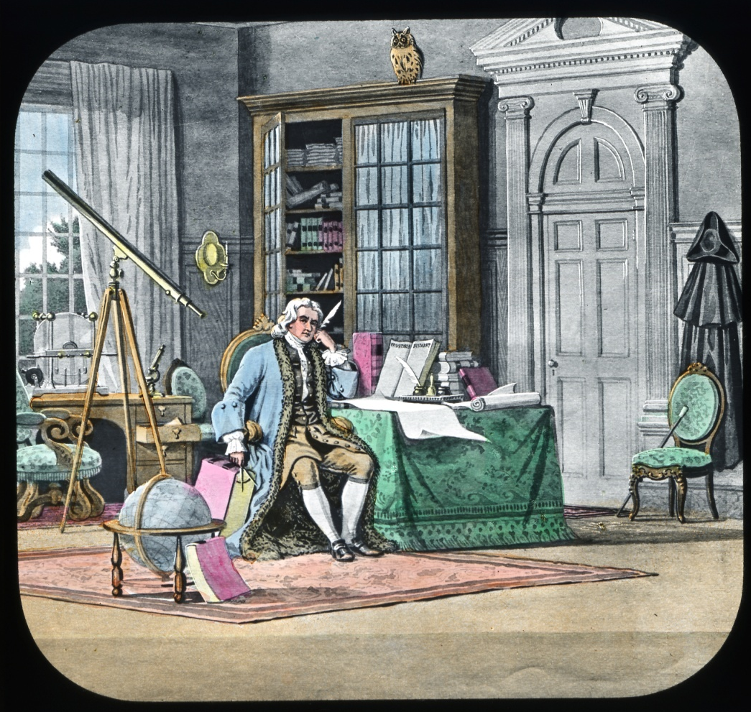
Are to me an open book.

Slide 12
I welcome you as a seeker of knowledge; but bear in mind, O neophyte, this truth -the wish to know contains not always the faculty to acquire. He who seeks to discover must first learn to imagine and to deliberate. The life that contemplates is nobler that the life that enjoys. He who merely is, may be a dull, insensate hind; he who knows is in himself divine.

Slide 13
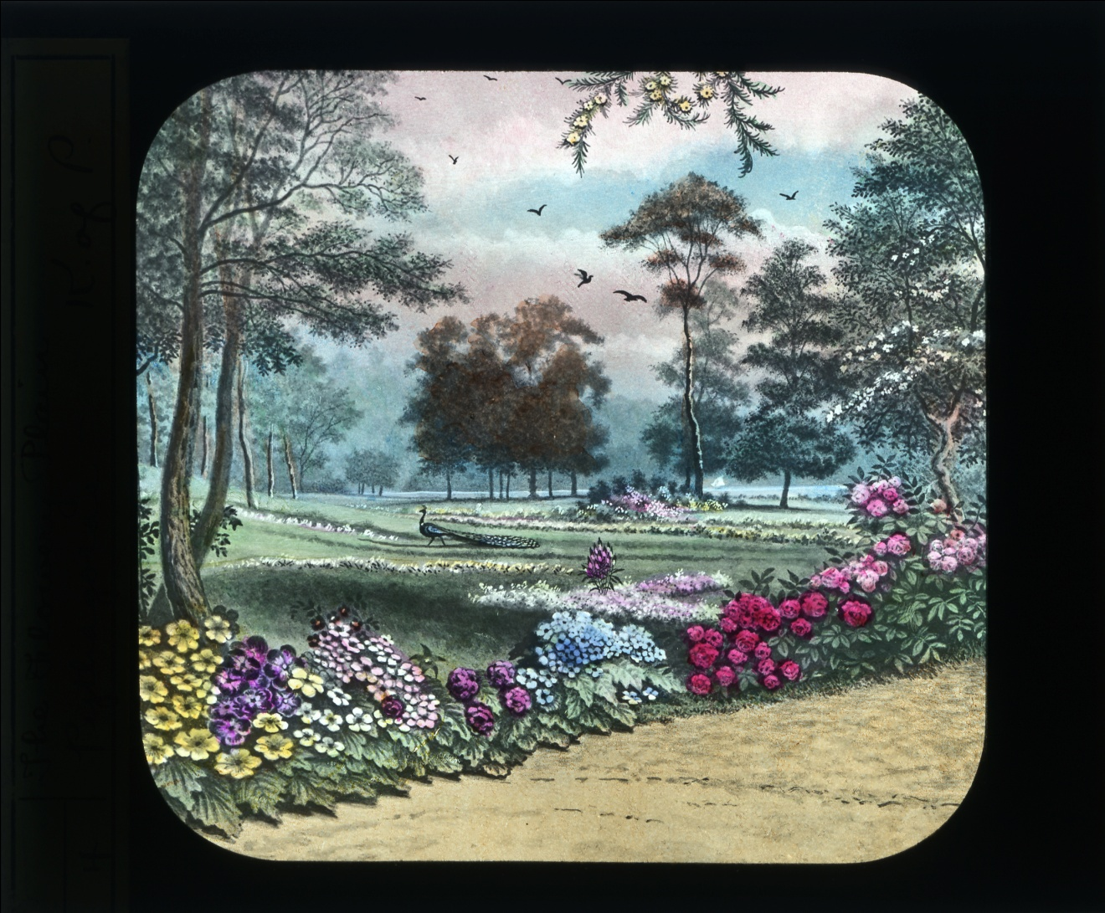
The journey which is before you is to you unknown. It lies, perhaps, through flower-bespangled plains and verdant meads, where summer sunshine sifts through interlacing boughs, and perfumed zephyrs sigh, and music-throated birds entrance the listening air.

Slide 14
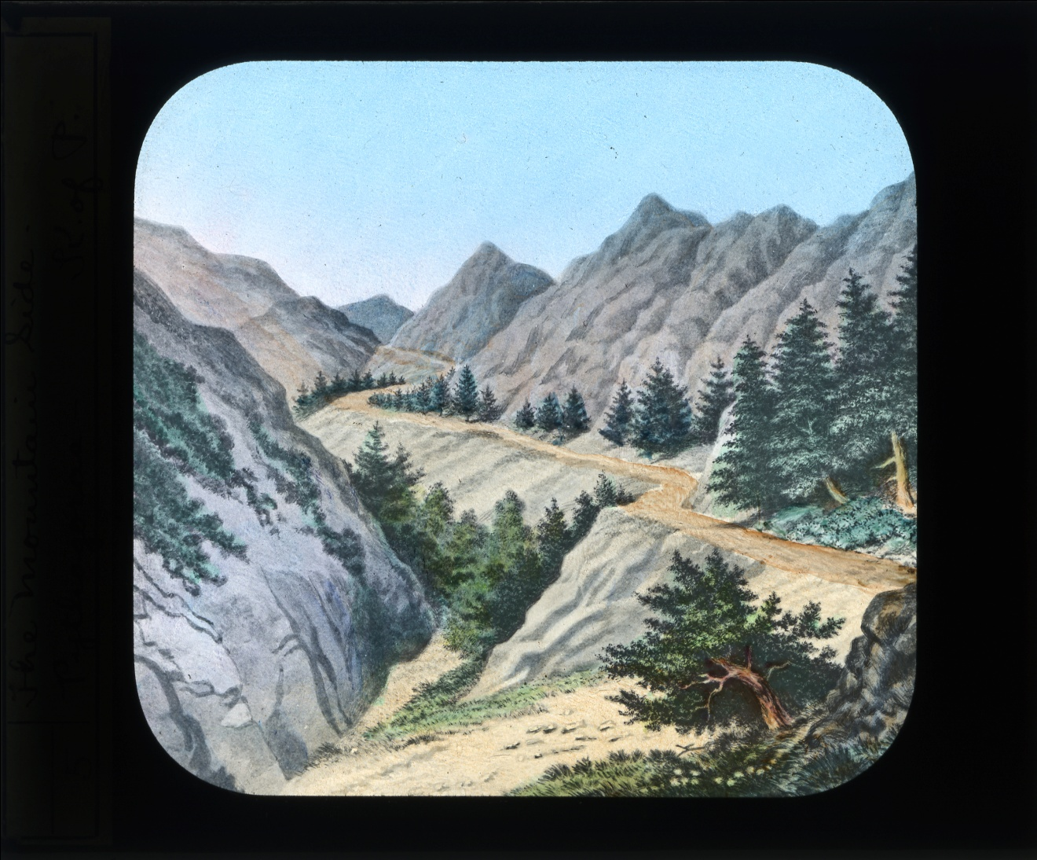
It per-adventure winds its devious and uncertain way along the mountain side, where unscaled peaks their towering summits lift amid the thunder’s sullen roar,

Slide 15
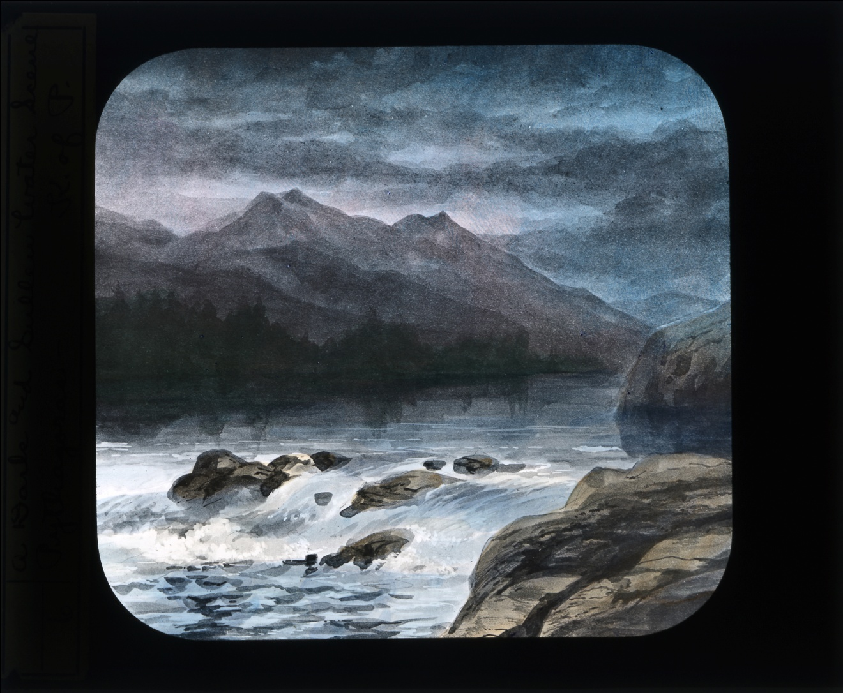
And depths abysmal yawn beyond the treacherous precipice; or else where darkling rivers run, ‘mid rayless gloom,

Slide 16
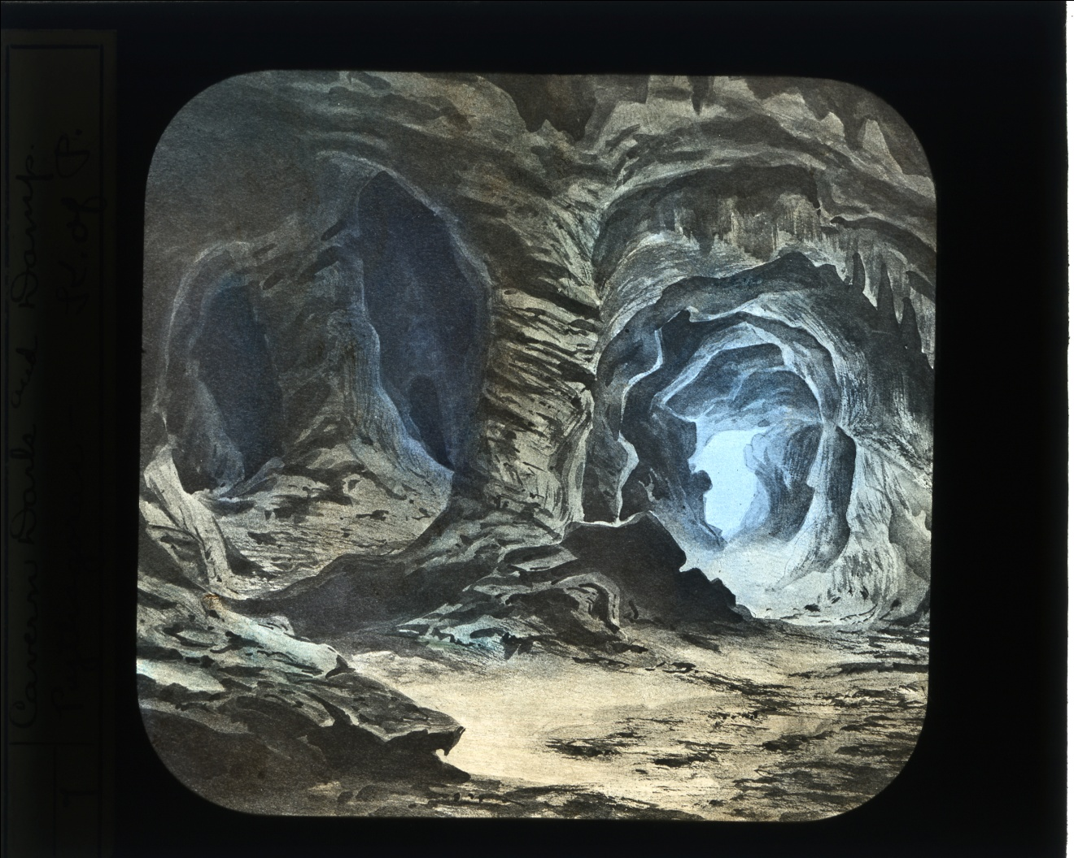
through caverns measureless to man,

Slide 17
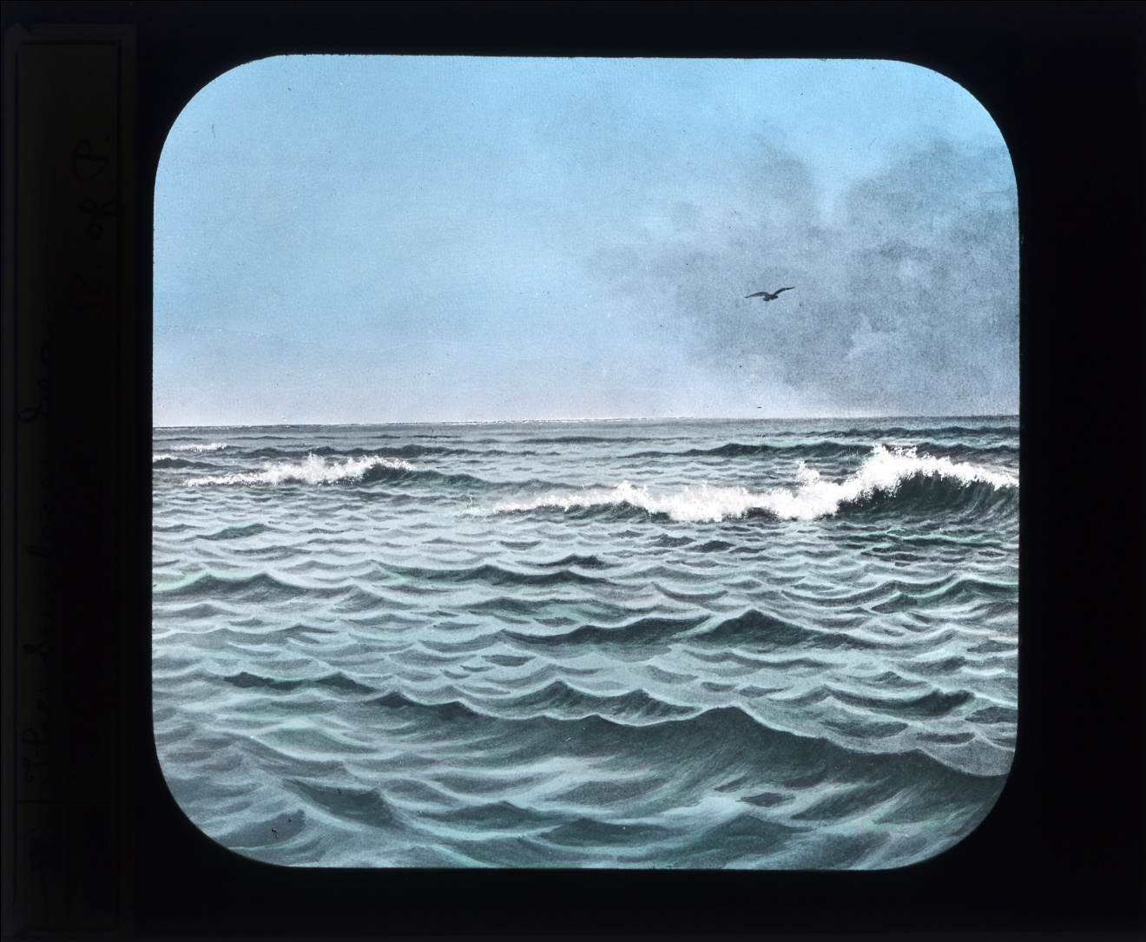
down to a sunless sea.

Slide 18
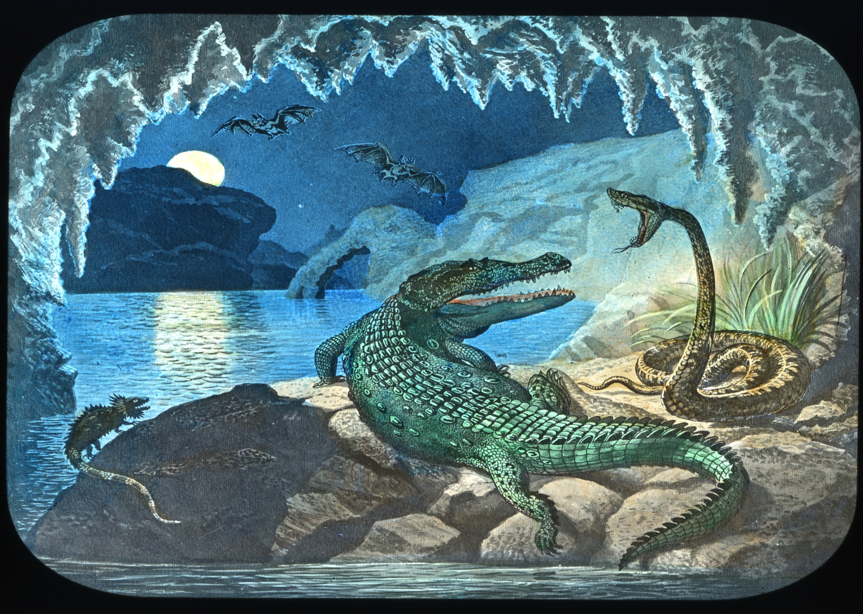
Mayhap it leads through bog and fen and foul morass, where hideous creatures climb and crawl, and slimy serpents cling and coil, and nameless, countless horrors lurk unseen

Slide 19
Fear is the deadliest foe to knowledge. Be brave. The coward fancies perils which may not exist, and dies a thousand deaths; to the hero danger comes only to nerve his arm and steel his soul to combat and to conquer.
An now, farewell. You go to claim the golden spur that knighthood wears. To wear it, you must win it. Should you succeed, your guerdon and reward will be companionship with loyal-hearted and chivalric knights; should you fail, on you and you alone will rest the burden of blame.

Slide 20
Chancellor Commander, before you stands________ strangers, who desires to be initiated into the mysteries of the rank of Page in the order of Knights of Pythias.

Slide 21
Chancellor Commander:
Stranger, favorable consideration of an applicant for the ranks of Knighthood is an expression of our belief in his honor and integrity. Being thus favored, it remains for you, when you have attained the ranks
of Knighthood, to make of this belief a verity.
That you may the better understand what you may see and hear, as step by step you advance in this great brotherhood,
I ask a listening ear.

Slide 22
This order does not rest its claim for favor solely upon its signs and symbols, but its ceremonies point the way to a higher and better standard of manhood.
It would develop and maintain character. and reputation would follow, as the night the day.

Slide 23
We do not claim nor expect perfection, but our hope is for better things. We realize the frailties and weaknesses of man, and from the lessons taught, we learn to overcome our own. Whatever of pleasure we may find along the way will prove your profit in the end.

Slide 24
In our ritualistic work, each sentence has a meaning, and each paragraph a lesson for your daily life. You will realize that friendship brings its full reward. The force and sting of hasty judgment may be yours, but caution has its part, and charity's broad mantle will
protect the thoughtless and the weak.

Slide 25
We believe that the unkind word is not an asset in the life of man; it brings naught of good. and once sent forth, is a liability which can never, never be redeemed. As you have faith in yourself, your honor and integrity, so have faith in the honor and integrity
of your fellowman.

Slide 26
Disregard of prudence that vanity may feast, is often seen, but much preferred is the
exercise of cautious judgment, and you will learn that confidence in others is as necessary to a successful life as the food we eat, the air we breathe, and the lovelight
of the home. We look for the good, the brighter, the better side of man.

Slide 27
This order, founded in the City of Washington, February 19, 1864, in its teachings, takes hold of the hearts of men, appeals alike to the high and the low,
to the learned and the unlearned, and strikes the chord of human sympathy found in all who do not live for self alone.

Slide 28
The story of Damon and Pythias is its basic thought;
every lesson taught has its application to life, day by day-as it was, is, and will be, through each unfolding year. Our wish, our hope, our aim, is that this order may aid you to be true, cautious, charitable, benevolent
and brave, in all that tends to make for good, in a world filled with golden opportunities to plant a Flower, and uproot a thorn along the path of life.

Slide 29
In this spirit, I welcome you as an applicant for the mysteries of this rank. In return for the honors we bestow on you, do you promise obedience? .
Master at Arms, the strangers having pledged obedience, you will conduct them to the Prelate of this lodge, who will administer to him the obligation of the rank of Page.

Slide 30
Master at Arms:
Prelate, by order of the Chancellor Commander, I present_______ strangers,
that you may administer to him the obligation of the rank of Page.

Slide 31
Prelate:
Advance on your left foot, place your left hand upon your left breast and close your right hand, raise your right arm as if to strike a downward blow and repeat after me!

Slide 32
Prelate:
I solemnly promise that I will never reveal the password, signs or any other secret or mystery of this rank, except in a lodge of this order, recognized by and under the control of the Supreme Lodge Knights of Pythias, or when being examined by the proper officer of a lodge, or to one whom I know to be a member of this order.

Slide 33
I further promise that I will not become a member of, recognize or countenance any organization using the name of this order or any derivative thereof, which
is not recognized by or under the control of the Supreme Lodge Knights of Pythias.

Slide 34
I further promise that I will obey the laws and, so far as possible, comply with the requirements of the order.
To the faithful observance of this obligation I pledge my sacred word of honor. So help me God-and may he keep me steadfast.

Slide 35
Prelate:
Until the mortal casket is forever stilled, no longer obeying for good or ill the behests of your immortal being, and soon to return to undistinguishable dust; and when your frame, like that on which you gaze, becomes an object lesson to be conned-a spectacle for curious or reflective minds to ponder o'er, and wonder if, once instinct with life, it sipped of every sinful sweet, and unremembered fell asleep; or if the hand, ne'er closed to human need, its largess so bestowed that e'en the fleshless and cadaverous palm could not the kiss of gratitude affright-may the record of your life be such that the briefest truthful thought must be, "He lived to bless mankind!"

Slide 36
Prelate. Master at Arms and attendants kneel on right knee.
ANTHEM
In the deep hush that o'er the earth is stealing,
. Father, I come to thee;
In humbleness of heart I kneel appealing
Be merciful to mel
Be merciful to me!
Prelate:
You will now arise.

Slide 37
Chancellor Commander:
Three raps.
Prelate:
My friend, you have pledged your sacred word of honor-man can give no higher pledge. You have called upon the ruler of the universe to aid you in keeping that obligation inviolate. You come to us in the strength of vigorous life, desiring to know our mysteries and willing to aid us in the work we have to do. As an order, we do not seek to shape your creed; but we do ask you to exercise your powers for good. In coming here, you assume no obligation in conflict with your duty to home and loved ones; and you can best honor us by your care of those who by the ties of home have claims upon you.

Slide 38
You have now not only your own good name to protect and defend, but, enrolled under
our banner, working for the elevation of mankind, do no act that will bring dishonor upon this order. We would have you fill the hours with kind words, the days with generous deeds; and as you meet your brethren,
"Be thou the rainbow to the storms of life,
The evening beam that smiles the clouds away!"

Slide 39
With pleasure I present to you a sprig of myrtle, which you will retain until its symbolism shall have been explained.
Master at Arms, conduct our friend to the Chancellor Commander for instruction and the lesson of friendship

Slide 40
.
Who comes here
Master at Arms:
The Master at Arms, with a friend who desires to receive further instruction in the mysteries of the rank of Page.
.
Chancellor Commander, the Master at Arms, accompanied by a friend who desires to receive further instruction in the mysteries of the rank of Page, applies for admission.
Chancellor Commander:
Admit them.

Slide 41
Master at Arms
Chancellor Commander, I present to you friends who desires to receive further instruction and the lesson of friendship.
Chancellor Commander
How am I to know that he has taken the obligation of the rank of Page?

Slide 42
Master at Arms:
They are in possession of a sprig of myrtle.
Chancellor Commander:
What does the myrtle symbolize?
Master at Arms:
The friendship which bound Damon and Pythias.
Chancellor Commander:
How should we exemplify that friendship?
Master at Arms:
By the practice of fraternity.

Slide 43
Chancellor Commander:
I accept the emblem [takes it from them] as an evidence of your intention to join us in the practice of fraternity; The motto of this rank is________________

Slide 44
The Outer Guard will open the door, obtain your name and report it to the Inner Guard, who will report it to the Vice Chancellor. If you are in good standing, the
Outer Guard will be ordered to admit you to the anteroom, where you will invest yourself with the jewel of a Page, bearing the letter "F" on a field of blue
blue being the emblematic color of this rank.

Slide 45
You will then approach the inner door and give thereon . :".• which will be answered from within by __________________
The wicket will then be opened, and through- it you will give your name. This will be reported to the Vice Chancellor, who will order you admitted if correct.

Slide 46
The wicket will again be opened, and through it you will give in a whisper the password of this rank, which is .. . You will then be admitted to the lodge room,
and will advance to the altar, on which will rest the open book of law, with two swords crossed underneath, the points toward you. There you will salute the Ragof our country, using the right hand military salute.
You will then give to the Chancellor Commander the sign of courtesy, thus: The Chancellor Commander will answer it by , which indicates permission to be seated.

Slide 47
Should you desire to retire while the lodge is open in this rank, unless leaving the lodge-room to execute an order of the Chancellor Commander, you will advance to the altar and salute the flag of our country. You will then give to the Chancellor Commander the same sign which you gave on entering the lodge-room. Should the Chancellor Commander answer it by _ , you may retire otherwise, you will return to your seat.
The motto of this rank is _______________

Slide 48
The gavel is the emblem of the authority of the Chancellor Commander, and is used to preserve order, call .be members of the lodge to their feet and seat them one rap calling the lodge to order, two raps calling all the members to their feet and three raps seating them.
Master at Arms, conduct our friend to the Chancellor Commander, that he may learn the lesson of this rank.

Slide 49
The friendship of Damon and Pythias shines through the mists of centuries, a glowing tribute to the humanity of the past. It was made the sweet song of ancient Greece, and is immortalized in the permanence of our order.

Slide 50
Damon, a senator of Syracuse, had incurred the displeasure of Dionysius, and was under sentence of death.
Many delighted to honor him when he wore the robes of office; now he has but one friend in all Syracuse-the companion of his brighter, better days.
Pythias was true; and knowing Damon's love of home, he begged the tyrant to grant his friend a respite, that he might see his wife and child before he died. A hero of many battles, a stranger to the art of speech, his love for Damon inspired a most eloquent appeal:

Slide 51
"As thou a'rt a husband' and a father, hear me!
Let Damon go and see his wife and child
Before he dies. For four hours respite him;
Put me in chains; plunge me into his dungeon,
As pledge for his return. Do this-but- this And may the gods themselves build up thy greatness As high as their own heavens!"

Slide 52
The fervor of this strange request touched the heart of Dionysius. It was to him a mystery. He had lived for self alone; he had sacrificed his friends, his honor
his home, upon the altar of a boundless ambition for place and for power. To him friendship was Ambition's ladder;

Slide 53
Whereto the climber upward turns his face; But when he once attains the upmost round, He then unto the ladder turns his back, Looks in the clouds, scorning the base degrees By which he did ascend.
“The request was granted, and Pythias became hostage for Damon, who hastened toward his home by the distant sea.

Slide 54
The mystery deepens-the tyrant cannot solve it By his decree, in the lone dungeon where Pythias wears the chains, the fair Calanthe urges her Iover to break his bond and fly with her where dangers can not come:
He will not go; he has pledged his word: his honor is more to him than life-and in his refusal the tyrant marvels still the more, Will Damon return? The love of home, of wife
child, the tender memories that shine like burning stars through the gathering gloom hold him, until ere he knows, the last hour of respite is hastening by.

Slide 55
Giving a last fond embrace to his loved ones-a last longing, lingering look at his once happy home he starts for Syracuse, to redeem his promise and to save his friend.
The hour of execution is at hand; Damon has not returned; and his hostage is brought to the block to suffer in his stead.

Slide 56
The evening sun shines golden on the towers and temples of ancient Syracuse, as Pythias looks out upon the vast throng, who' taunt him with the seeming falseness of his friend. Relying upon the honor of Damon, trusting in his word, proud of his
friendship, he calls upon the gods to prevent his return'. and, in response to the cruel jeers of the mob, proclaims the fidelity of Damon, and turns to meet his fate.

Slide 57
At the last moment, when the headsman's axe is raised, a horseman is seen in the distance, coming with the speed of the wind, It is Damon! He has been true to his promise. He has saved his friend.

Slide 58
The air resounds with the shouts of the populace, in recognition of a virtue that has long been buried under the weight of human selfishness. At the strange scene the tyrant looks in wonderment; and, as he looks, the cruel purpose of the hour passes
away, and friendship sits upon the throne, wearing a crown "that ne'er encumbers nor can be transferred."

Slide 59
These heroes still live, and will live while friendship warms the heart of man. This virtue is the cornerstone of the order, and our members are sworn to exercise it toward each other.
Keep sacred the lesson of to-night; and so live that, when you come to the river that marks the unknown shore your hands may be filled with deeds of charity, "the golden keys that open the palace of eternity.
“I now confer' upon you the rank of Page in the order of Knights of Pythias.

Slide 60
Officers and members of STONEWALL-JASPER Lodge, No 6, I take pleasure in introducing Pages
The lodge will be at ease

